Slide 1
Javascript

Slide 2
Content
Tools & Environment Setup
GIT & Github Basics.
JavaScript Language Basics
How JavaScript Works Behind the Scenes
JavaScript in the Browser: DOM Manipulation and Events
Project 1 – The Dice Pig Game
Advanced JavaScript: Objects and Functions
Project 2 – The Budget App
Next Generation JavaScript: ES6+ / ES2015+
Asynchronous JavaScript: Promises, Async/Await and AJAX
Project 3 – The Recipe App - Modern JavaScript: Using ES6+, NPM, Babel and Webpack
Deployement on Github Pages.

Slide 3
Content - Detail
Tools & Environment Setup
    Download and Installation
    VS Code Extensions Intallation.
GIT & Github Basics.
JavaScript Language Basics
How JavaScript Works Behind the Scenes
JavaScript in the Browser: DOM Manipulation and Events
Project 1 – The Dice Pig Game
Advanced JavaScript: Objects and Functions
Project 2 – The Budget App
Next Generation JavaScript: ES6+ / ES2015+
Asynchronous JavaScript: Promises, Async/Await and AJAX
Project 3 – The Recipe App - Modern JavaScript: Using ES6+, NPM, Babel and Webpack
Deployement on Github Pages.

Slide 4
Classwise Schedule
Tools & Environment Setup (Class 1)
GIT & Github Basics. (Class 1)
JavaScript Language Basics (Class 2)
How JavaScript Works Behind the Scenes (Class )
JavaScript in the Browser: DOM Manipulation and Events (Class )
Project 1 – The Dice Pig Game (Class )
Advanced JavaScript: Objects and Functions (Class )
Project 2 – The Budget App (Class )
Next Generation JavaScript: ES6+ / ES2015+ (Class )
Asynchronous JavaScript: Promises, Async/Await and AJAX (Class )
Project 3 – The Recipe App - Modern JavaScript: Using ES6+, NPM, Babel and Webpack (Class )
Deployement on Github Pages. (Class 16)

Slide 5
Tools & Environment Setup
OS: Ubuntu Linux 18.04 LTS
Editor: VS Code
Browser: Chrome
Version Control: GIT
Online Code Repository: Github.com

Slide 6
Tools & Environment Setup
Download & Installation Links
OS: Ubuntu Linux 18.04 LTS
    Download URL: https://ubuntu.com/download/desktop
    Installation Tutorials
      Ubuntu Installation :
      https://tutorials.ubuntu.com/tutorial/tutorial-install-ubuntu-desktop#0
      Ubuntu Installation as Dual Boot with Windows:
      https://itsfoss.com/install-ubuntu-dual-boot-mode-windows
Editor: VS Code
    Download URL: https://code.visualstudio.com/download
Browser: Chrome
    Download URL: https://www.google.com/intl/en_sg/chrome/
Version Control: GIT
    Download URL: https://git-scm.com/downloads
    GIT Commands Cheetsheet:
      https://www.atlassian.com/dam/jcr:8132028b-024f-4b6b-953e-e68fcce0c5fa/atlassian-git-cheatsheet.pdf
Online Code Repository: Github.com
    Sign Up for Free Github.com Account: https://github.com

Slide 7
VS Code - Extensions
Auto Rename Tag
Live Server
Prettier
Useful Link: https://www.youtube.com/watch?v=bhu7-5x46BM

Slide 8
GIT
Distributed Version Controlling System (VCS).
Developed by Linus Torvalds, who is well known for Linux Kernel.
Most used VCS:
  https://insights.stackoverflow.com/survey/2018#work-_-version-control
GIT is Open Source hava a look at it’s code here: https://github.com/git/git
Good Read:
  https://guides.github.com/introduction/git-handbook/
  https://speakerdeck.com/schacon/introduction-to-git
  https://www.atlassian.com/git/tutorials/what-is-version-control

Slide 9
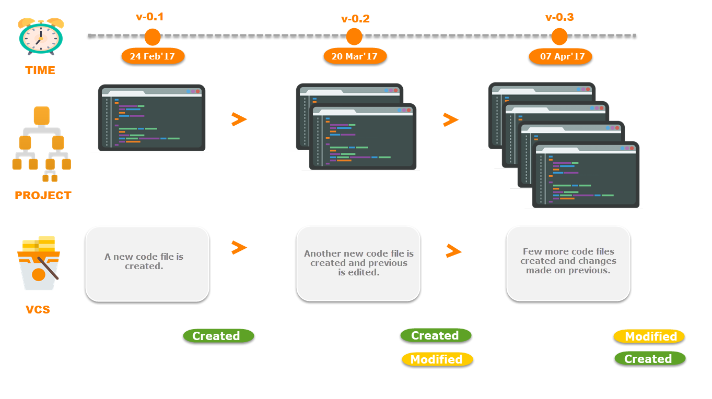
What Version Controlling System (VCS) ?
It is a software that maintain different versions of a file on computer system.

Slide 10
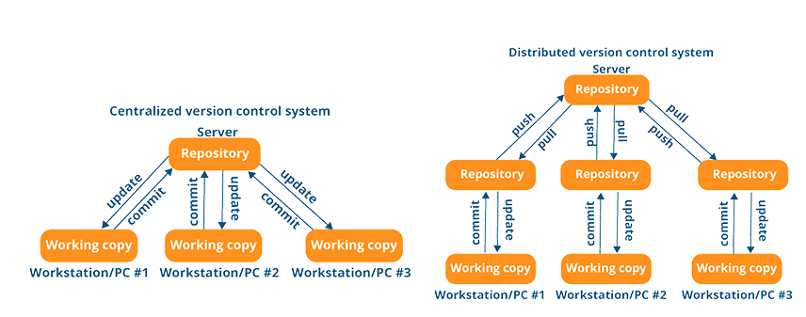
Centralized(C) vs Distributed(D) Version Controlling System (VCS)

Slide 11
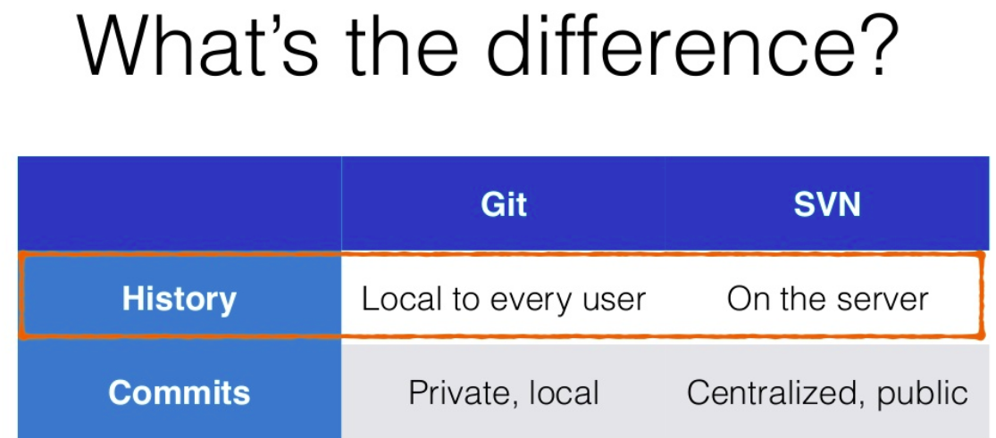

Slide 12
Practice
Git - Local
Create folder and then create your File(s) or Project(s) in that folder to manage versions.
Initialize Git on to the newly created folder.
Stage Changes.
Commit Changes Locally.
Do some more changes to your file(s) or project(s).
Repeat steps 3 to 5 and see History locally.

